Slide 1
Using Deep Learning to make real-time predictions of glycosylation in Monoclonal Antibodies
November, 7th 2019
Deepro Banerjee
Notes:
Good morning everyone. Today I will present the work I have done for my master’s research project. The topic is using deep learning to make real-time predictions of glycosylation in mAbs.

Slide 2
Agenda
Advancement of Bio-pharmaceuticals in the global pharmaceuticals market
Monoclonal Antibodies and Glycosylation in mAbs
Current Glycosylation models and the proposed model
Static Approach
Dynamic Approach
Combined Approach to make real-time predictions
Conclusion and Future Work
Notes:
The topics that I will discuss today are listed here. Firstly, I will talk about the growing impact of biopharmaceuticals in the global pharmaceutical market. Then I will move on to monoclonal antibodies and describe glycosylation as one of the critical quality parameters in monoclonal antibodies. The third part deals with current glycosylation models and I will also introduce my proposed model. The next two parts are the two approaches that I have used to design the model based on the availability of data. The final approach is a combination of the two that I will discuss in the Combined Approach to make real-time predictions section. And finally I end with how the model will be useful

Slide 3
Global Pharmaceutical Market
and Biopharmaceuticals

Slide 4
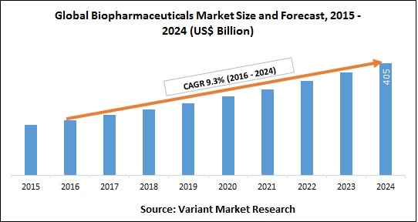
Rapid advancement of biopharmaceuticals

Slide 5
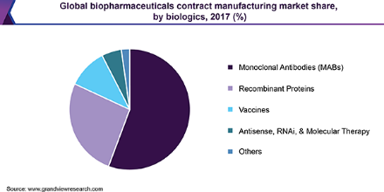
Monoclonal Antibodies (mAbs) has the largest share

Slide 6
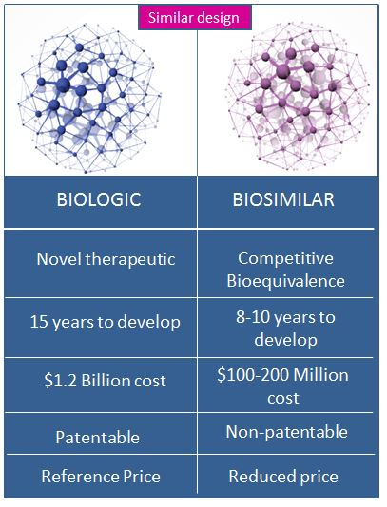
Despite the therapeutic benefits, biologics are expensive

Slide 7
Maintaining drug product quality has occupied the center stage of the biopharmaceutical industry
Since biosimilars differ only in their quality profiles with the innovator molecule, regulatory agencies are seeking extensive characterization of the complete quality attributes of the drug
Shift in the focus from improving productivity to maintaining consistent product quality across batches
To ensure product safety and efficacy

Slide 8
mAbs and glycosylation

Slide 9
mAbs are a type of protein used to treat many diseases
Largest fraction of marketed biopharmaceuticals and those in clinical development
Prescribed for treating breast cancer, colon cancer, Crohn’s disease to rheumatoid arthritis
Despite the therapeutic benefits, they present a financial burden on the healthcare system
Notes:
A type of protein made in the laboratory that can bind to substances in the body, including cancer cells. There are many kinds of monoclonal antibodies. A monoclonal antibody is made so that it binds to only one substance. Monoclonal antibodies are being used to treat some types of cancer. They can be used alone or to carry drugs, toxins, or radioactive substances directly to cancer cells.

Slide 10
Glycosylation is one of the most important determinants of mAb quality
Terminal galactosylation has been found to impact CDC activity
Core fucosylation has been found to impact ADCC activity
Terminal sialylation has been found to impact inflammatory properties as well as ADCC activity
Notes:
complement-dependent cytotoxicity (CDC), antibody-dependent cytotoxicity (ADCC)…

Slide 11
Unfortunately, with current technology, glycosylation can only be determined post-production
Online measurements for glycosylation are not available
Obtaining a comprehensive understanding of glycosylation is challenging due to the complexity of the intracellular process
Comprehensive control paradigms tailor-made for glycosylation control objectives are non-existent.

Slide 12
Current Models and Proposed Model

Slide 13
Current Glycosylation Models lack generalization ability
Fails to adapt to different cell lines
Fails to adapt to different bio-reactor conditions
Does not take previous time-steps into account
Helps to understand the underlying physics behind glycosylation
Fails to adapt to:

Slide 14
Proposed model uses data-driven techniques to make predictions
Uses data-driven techniques instead of first principles based methods
Generalizes well to Ambic and CDOptiCHO cell-lines
Takes all the previous time steps into account
Not good at explaining the underlying physics behind glycosylation

Slide 15
The Model has 3 different approaches
Static Approach
Dynamic Approach
Combined Approach

Slide 16
Static Approach

Slide 17
Static Approach requires data throughout the entire time span of the experiment
Data Collection
Data Pre-processing
Data Visualization and Analysis
Deep Learning Model
Model Prediction
Model Evaluation

Slide 18
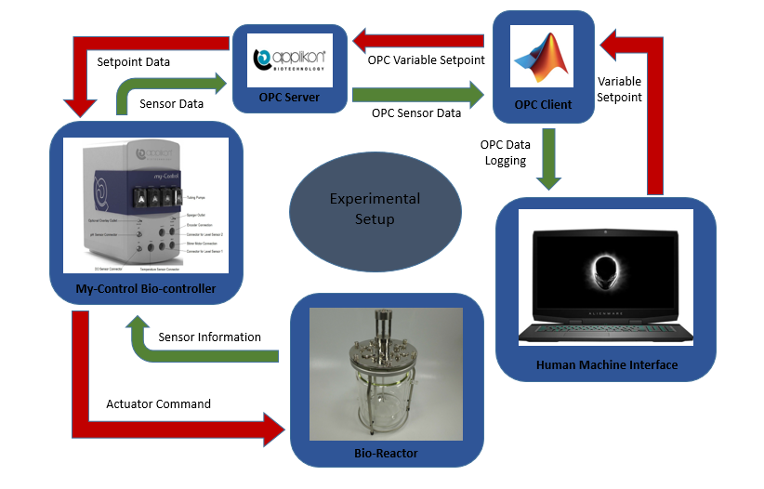
Data Collection Flowsheet

Slide 19
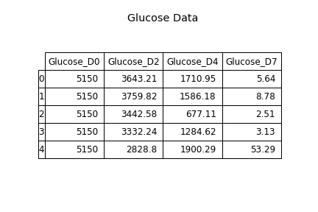
Data Preprocessing involved selecting variables and creating feature space
1. Glucose concentration profile
2. Glutamine concentration profile
3. Lactate concentration profile
4. Ammonia concentration profile
5. Viable cell density profile
6. Total cell density profile
7. Antibody concentration profile
8. The final relative glycan distribution
Notes:
Independent and dependent

Slide 20
Data Visualization and Analysis to find correlation
Correlation among the independent variables will result in inconsistent predictions
Pearson Correlation helps to find linear relation between the variables
Spearman Correlation helps to find monotonous relation between the variables

Slide 21
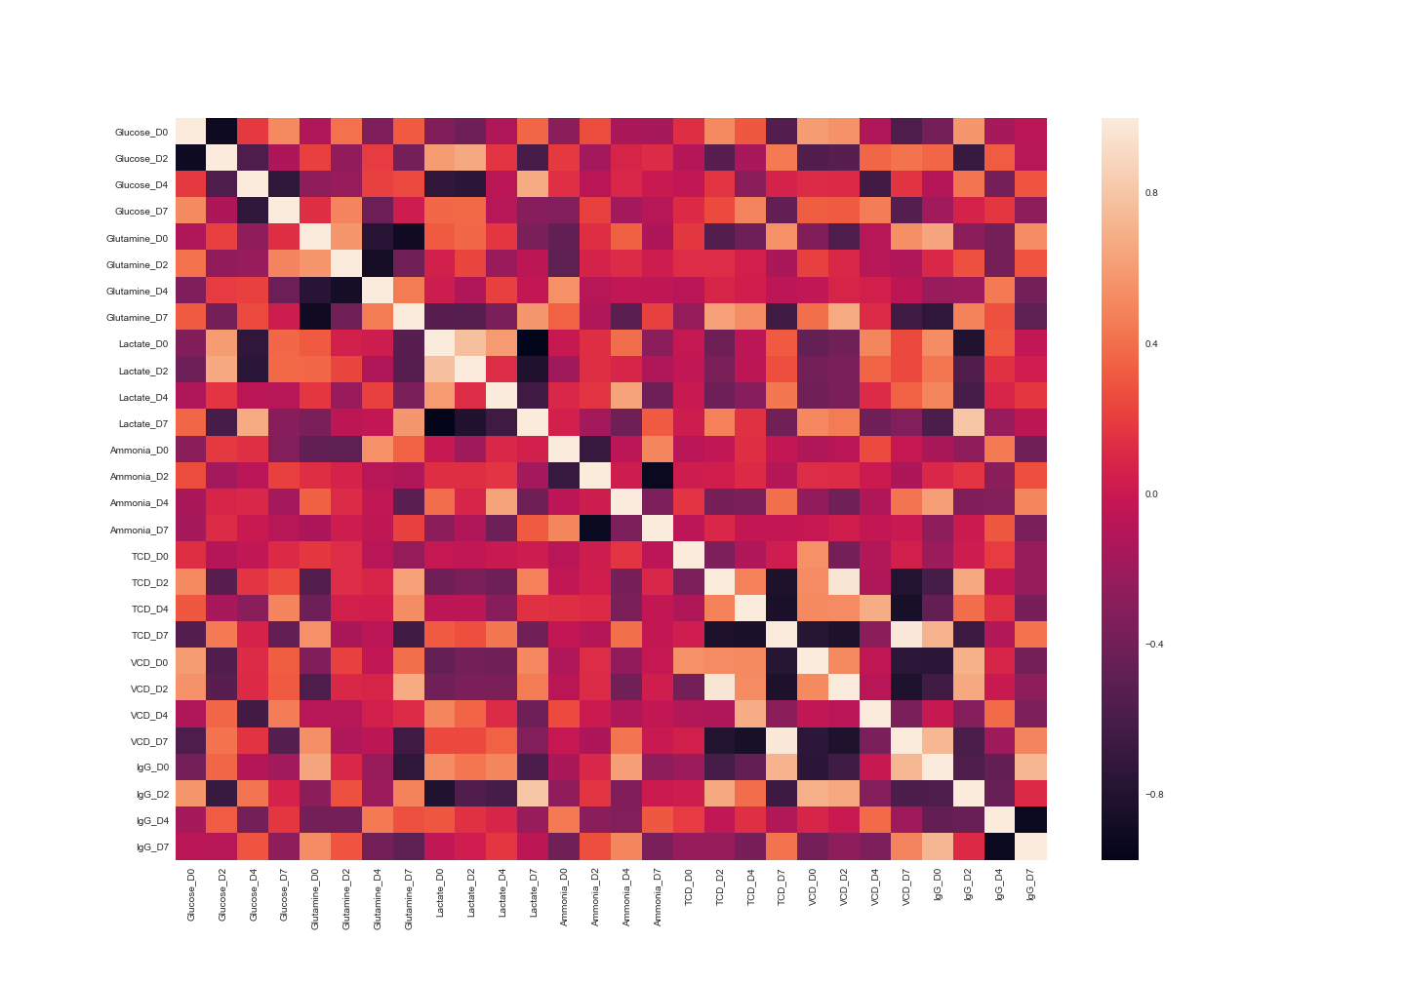
Pearson’s Correlation showed 182 linear interactions

Slide 22
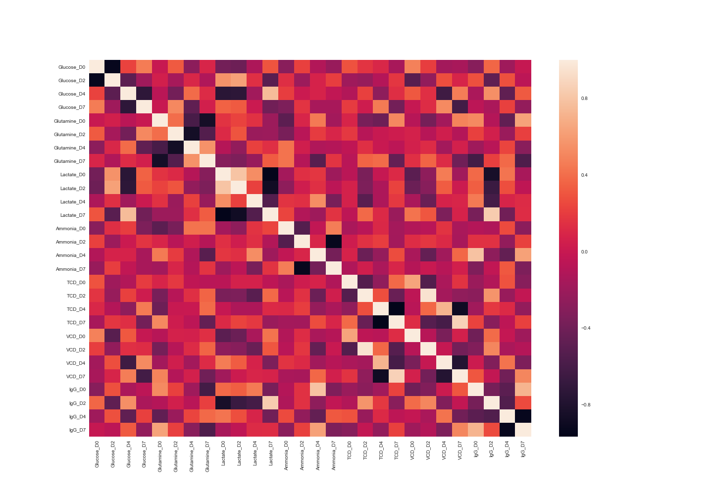
Spearman’s Correlation showed 118 monotonous interactions

Slide 23
Reduced the feature space using Principal Component Analysis
Model Characteristics
Results
Converts a set of observations of possibly correlated variables into a set linearly uncorrelated variables
Helps to select the components that accounts for the maximum variance in the data
Significantly reduces the computation time
95% of the variance is explained by 6 components
Reduced the feature space from 28 to 6
Increased computational efficiency

Slide 24

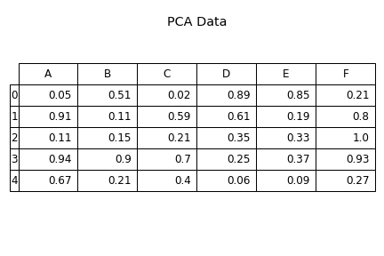
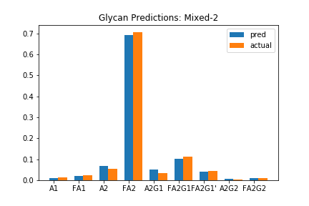
A deep neural network was trained on the processed data

Slide 25
The Deep Learning Model Architecture after hyperparameter optimization
Hidden Units: 3
Hidden Layers: 4
Activation function: "logistic"
Learning rate: 0.001
Regularization penalty: L2
Regularization parameter: 0.0001

Slide 26
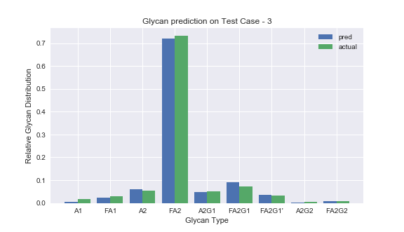
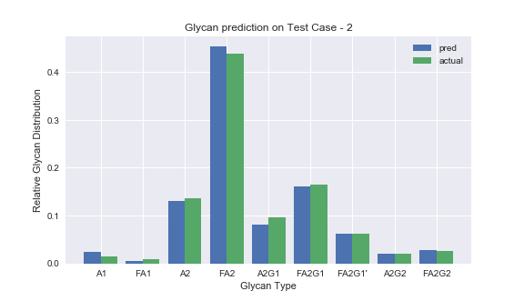
Model Prediction on 2 test cases

Slide 27
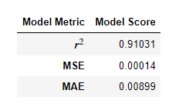
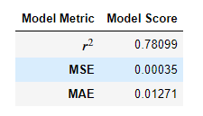
Comparing the model to Multivariate Linear Regression
Deep Learning Model
Multivariate Linear Regression

Slide 28
Dynamic Approach

Slide 29
Dynamic Approach makes continuous predictions of antibody concentration
Pooled Model (Works with both time series and cross sectional data)
Based on a Recurrent Neural Network with LSTM cells
Takes multivariate time series data as input
Makes continuous predictions of the antibody concentration till the end of the experiment

Slide 30

RNNs have an internal memory

Slide 31
Same variables, different information
We will work with the same set of variables
We will continuously feed information to the dynamic model till the current time-step
The model can deal with variable time-steps as well
The model will output the antibody concentration profile for the remaining part of the experiment

Slide 32
Dynamic Model Visualization
Time Step 1 Information
Time Step (i +1) Information
.
.
.
.
.
.
LSTM
Time Step (i -1) Information
Time Step (6) Information
Time Step (i) Information
Time Step (7) Information
We pass all the information up to time step i to our model
It predicts the information for the next 7- i days

Slide 33
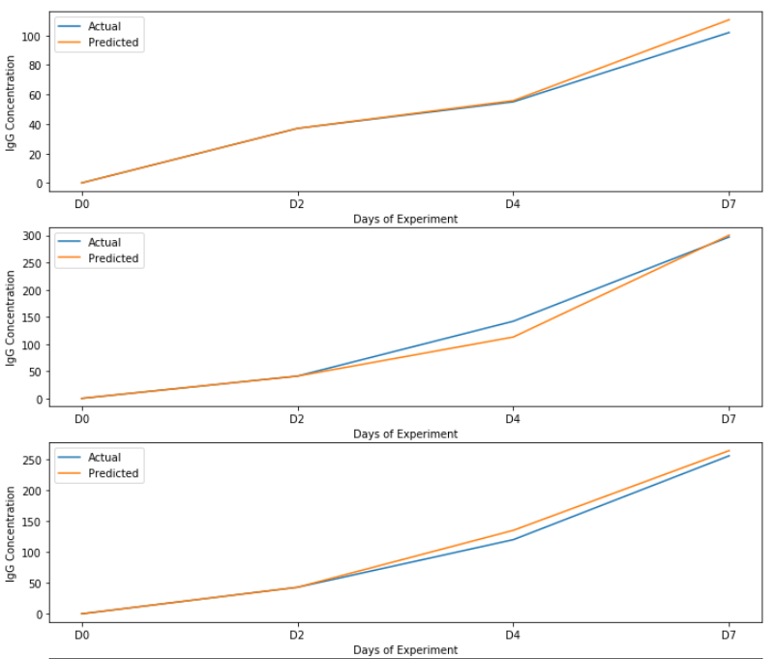
The Dynamic Model predicts the antibody concentration profile with an MSE of 0.00579

Slide 34
Combined Approach

Slide 35
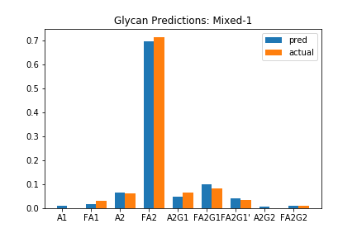
Combined Approach Flowsheet
LSTM
Information
till
Time Step (i)
Information from Time Step (i+1) till the end
LSTM
Static Model

Slide 36
Conclusion and Future Work

Slide 37
Conclusion
The proposed framework presents an efficient way to continuously predict the final relative glycan distribution in mAbs
The model is independent of AMBIC and CDOptiCHO cell lines or the addition of supplements
It can be used to save days of experimental time
It can be used to design an effective controller to manipulate glycosylation in mAbs

Slide 38
Future Work
The model can be used to train on other cell-lines as well
With more data, the dynamic model can be used to continuously predict the media concentrations, total and viable cell density as well
The robustness of the model can be increased with more data where the experiment has gone wrong
Currently the model is more biased towards the CDOptiCHO cell-line. It needs to be trained on more AMBIC data
Other variables like pH, temperature, dO2 can also be incorporated in the model

